Slide 1
Mapping Strategies for Complex Data
Clark Library
Spatial and Numeric Data
Justin Joque
Nicole Scholtz
2015

Slide 2
Overview
Thinking about complex data
Creating new metrics
Exercise I
Overlays and Transparency
Exercise II
Point Densities
Exercise III
Conclusions and Questions

Slide 3
Complex data
Things to consider:
What are you trying to show?
Why a map?
What have other people done?
Is the map ‘readable’?

Slide 4
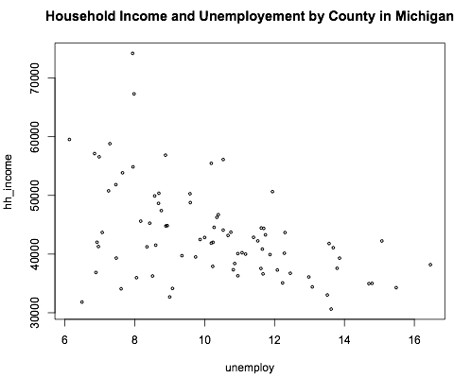
Complex data

Slide 5
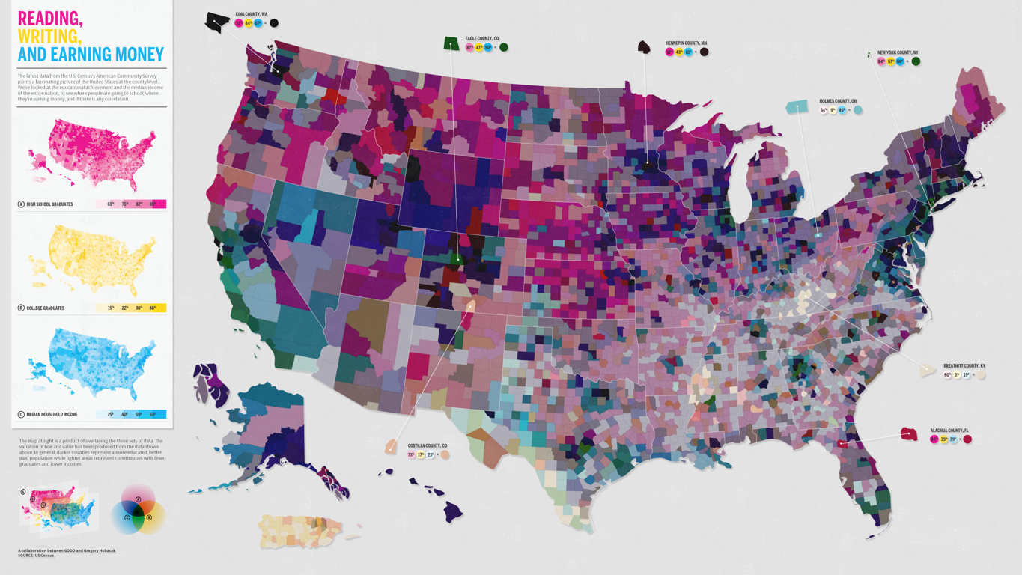
Complex data
http://awesome.good.is/transparency/web/1101/census-data/flat.html

Slide 6
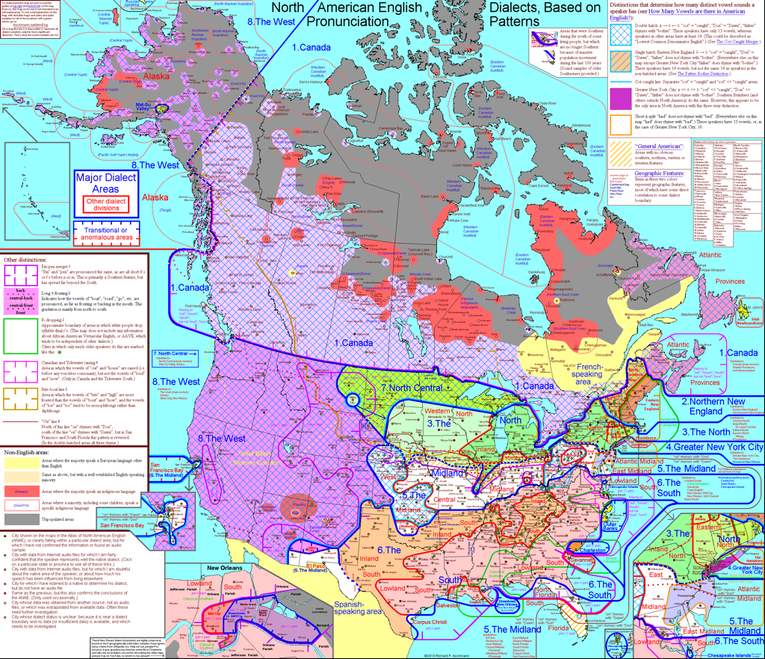
Complex data
http://aschmann.net/

Slide 7
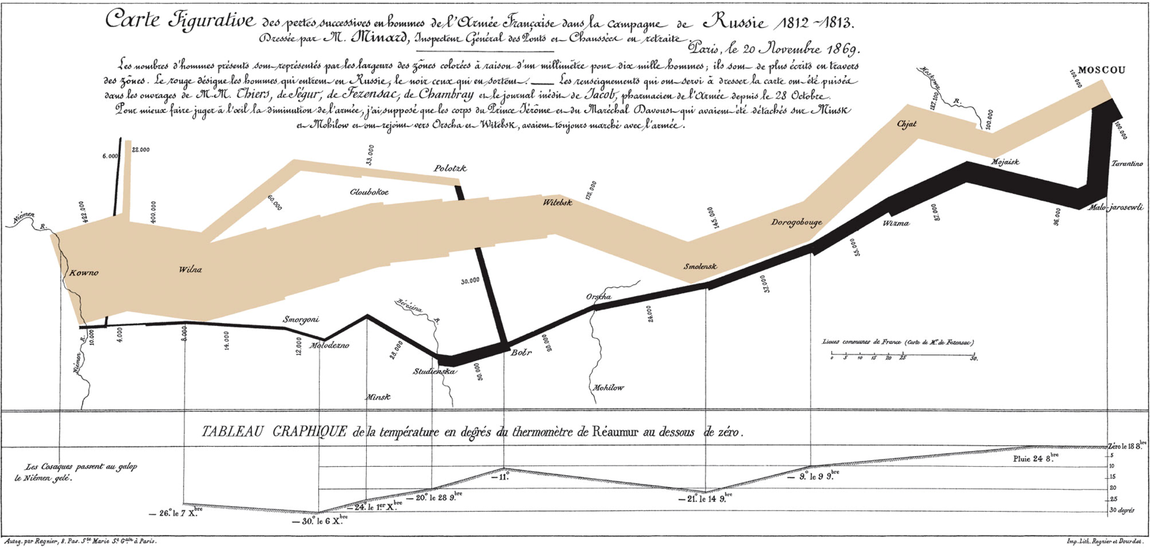
Complex data
This article from the Economist discusses this map and also provides a link to a high quality reproduction of it: http://www.economist.com/node/10278643?story_id=10278643

Slide 8
Creating new metrics
How do your variables interact?
Can they be combined into a single variable?

Slide 9
Exercise I
Say we are interested in income and rent in Michigan. How could we create a single variable to show (at least part of) the relationship between the two?

Slide 10
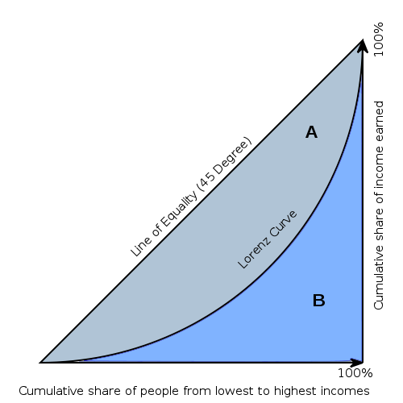
Creating new metrics: Gini Coefficient

Slide 11
Overlays & Transparency
http://awesome.good.is/transparency/web/1101/census-data/flat.html

Slide 12
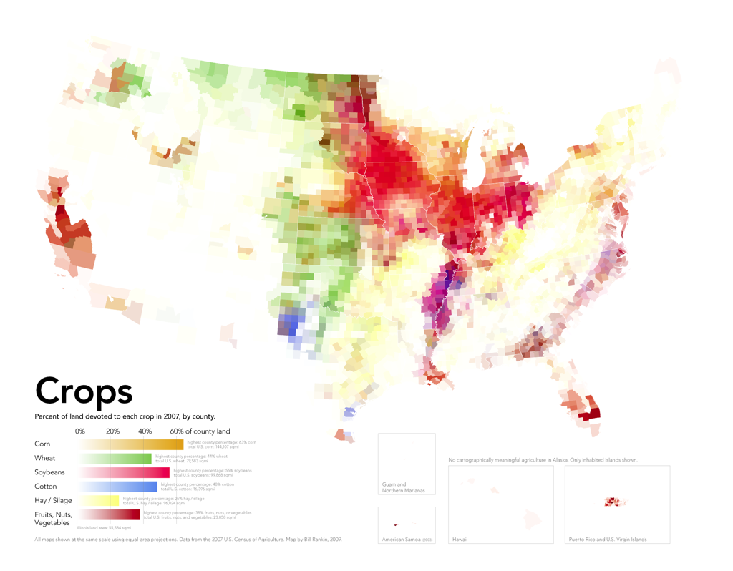
Overlays & Transparency
http://www.radicalcartography.net/

Slide 13
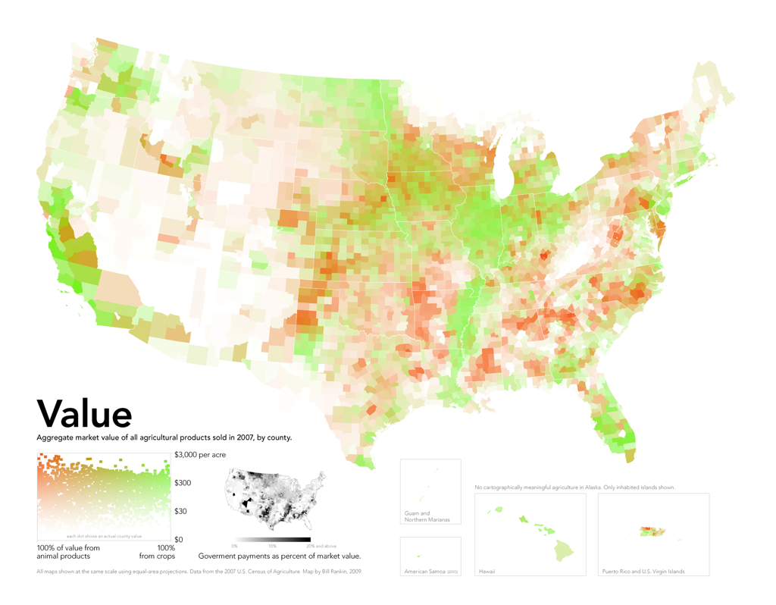
Overlays & Transparency
http://www.radicalcartography.net/

Slide 14
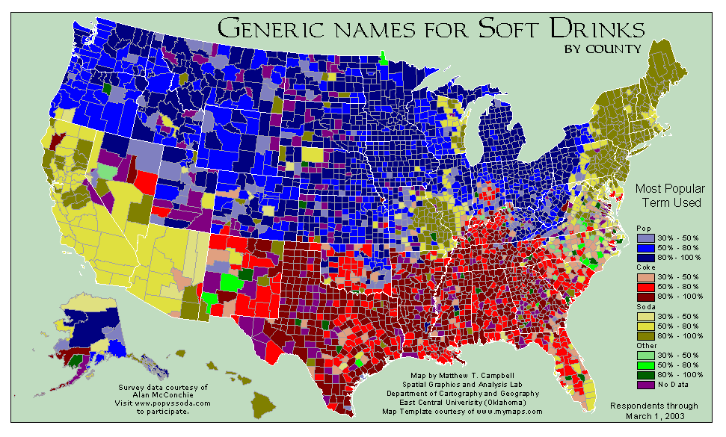
Overlays & Transparency

Slide 15
Exercise II
Part I - we’ll use transparency to add more information to our rent/income map
Part II - we’ll look at race in Michigan

Slide 16
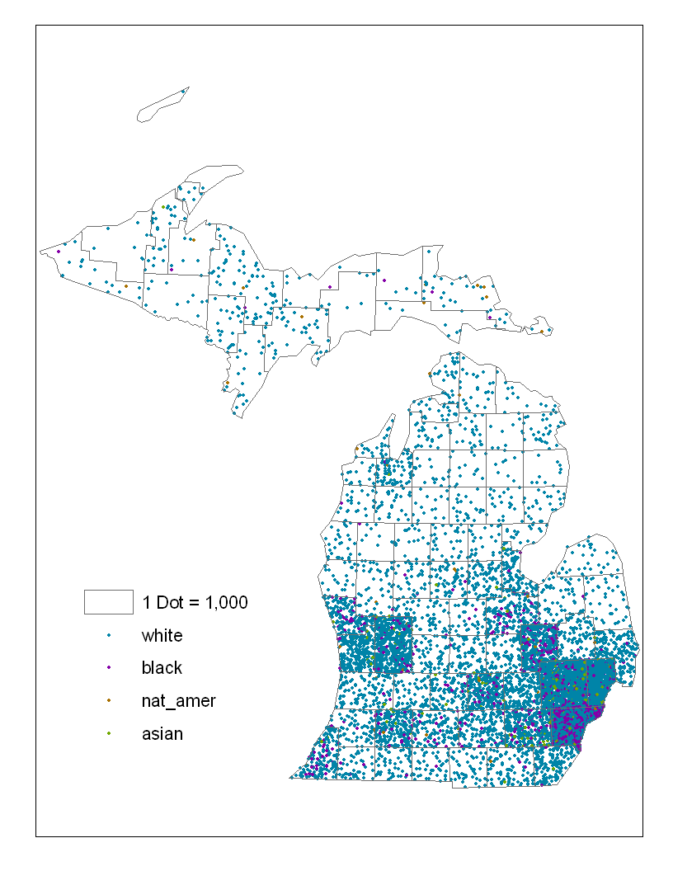
Point densities

Slide 17
Exercise III
We will use point densities to represent race in Michigan.

Slide 18
Conclusions and Questions
Thank you for coming
Please fill out the evaluation form
There is a link on the ctools site under resources

